Slide 1
Introduction to Routing and Spectrum Allocation (RSA) in Optical Networks
Divya K

Slide 2
Welcome and Overview
What is Routing and Spectrum Allocation (RSA)?
Learning Objectives:
Understand the concept of RSA
Know the key components of optical networks
Learn how routing and spectrum decisions are made

Slide 3
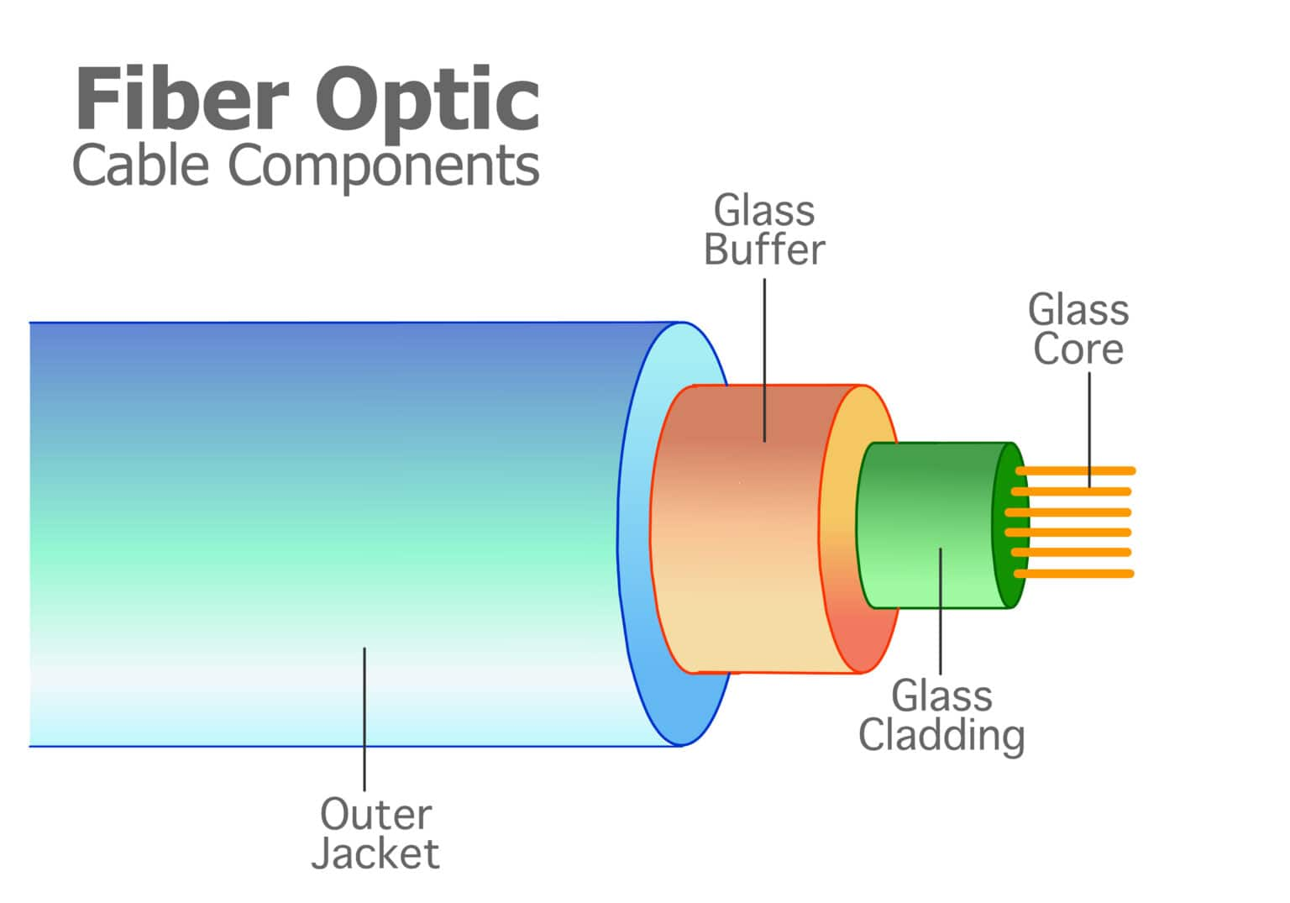

What is an Optical Network?
A network is a collection of connected devices that exchange data
In optical networks, data travels as light through fiber cables

Slide 4
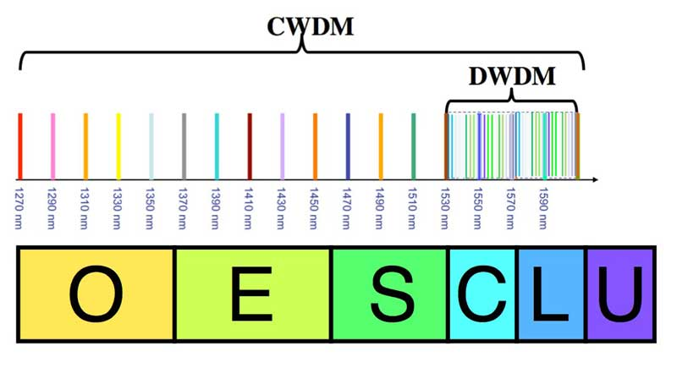
What is an Optical Network?
Components:
Nodes (routers/switches)
Links (fiber cables)
Spectrum (set of frequency slots)
Source: The starting point of the data
Destination: Where the data is going
B
C
Src
Dest
A
F
D
E
Notes:
Explain frequency slots using the traffic and lanes example

Slide 5
How to Find the Shortest Route
The shortest route = the path with the least distance or hops
Given Example: By hop count
shortest path: A – B – C – F or A – D – E – F
Algorithm used: Dijkstra’s Algorithm
By the least distance
Shortest path: A – B – D – E – F
9
B
C
11
4
Src
Dest
A
2
5
F
13
D
E
6
3

Slide 6
The RSA Problem Defined
Goal: Find a path (route) and assign spectrum slots
Must avoid interference and ensure availability
Constraints:
Spectrum continuity (same slot used on every link in the path)
Spectrum contiguity (slots must be next to each other)
Non-overlapping spectrum assignment (no reuse on the same link)

Slide 7
Understanding Routing
Routing = Selecting a path from source to destination
A path is made of a sequence of links (like roads between cities)
Considerations:
Network layout (topology)
Which links are available
9
B
C
11
4
Src
Dest
A
2
5
F
13
D
E
6
3

Slide 8
Understanding Spectrum Allocation
Each link has a number of frequency slots (like lanes on a road)
Goal: Assign a group of slots that are:
Available on all links of the path
Next to each other (contiguous)
Why it matters:
Avoid signal interference
Make efficient use of the network

Slide 9
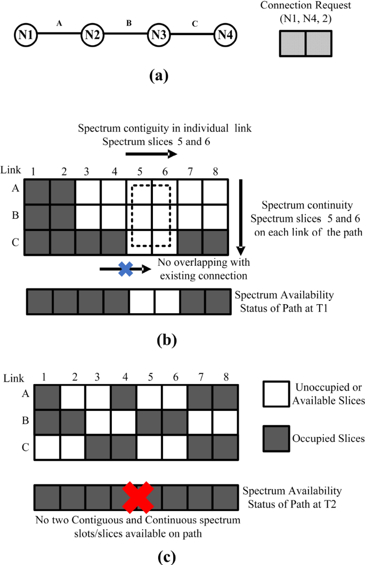
Understanding Spectrum Allocation
Constraints
Continuity
Contiguity
Non-overlapping

Slide 10
RSA Example
Spectrum slot req – 3
A – B – C – E – F : Slots 4, 5, 6
B
C
Src
Dest
A
F
D
E

Slide 11
Why RSA is Important
Without RSA:
Data could get delayed or blocked
The network could waste bandwidth
With RSA:
Better use of available resources
Faster and more reliable communication

Slide 12
Summary and Questions
Routing: Choosing a path
Spectrum Allocation: Choosing frequency slots
RSA helps make networks faster and more efficient
Any questions?

Slide 13
resources
https://www.researchgate.net/publication/307873989_Study_and_Analysis_of_Routing_and_Spectrum_Allocation_RSA_and_Routing_Modulation_and_Spectrum_Allocation_RMSA_Algorithms_in_Elastic_Optical_Networks_EONS
https://www.youtube.com/watch?v=gQtgtKtvRdo&ab_channel=SabinCivilEngineering
https://www.youtube.com/watch?v=Cwv54dV-a7s&ab_channel=LeslieRusch

